Slide 1
The App

Slide 2
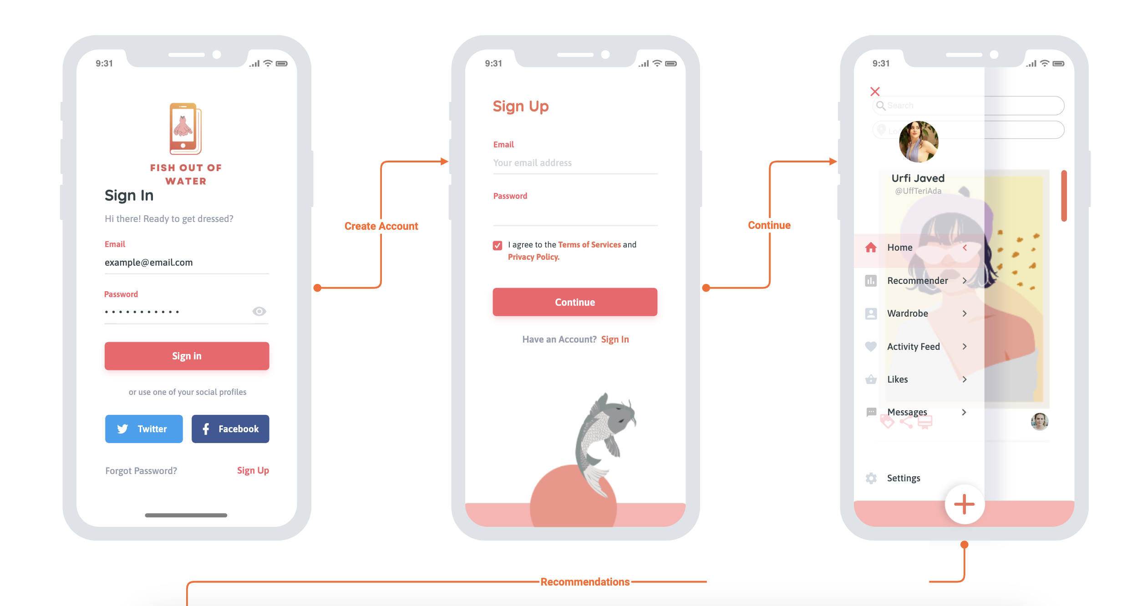

Slide 3
